Slide 1
E-commerce Product Delivery Prediction
Prepared by: Piyush Thakur

Slide 2
Agenda
Introduction
Data Description
Methodology
Key Insights
Model Performance
Conclusion
Recommendations
Future Work
Questions

Slide 3
Introduction
The company, specializing in electronic products, seeks insights from its customer database to optimize delivery performance and enhance customer satisfaction.
The goal is to predict whether products will reach customers on time using machine learning models.
By analyzing factors affecting delivery timeliness, the company aims to refine its logistics strategy and reduce delivery delays.

Slide 4
Data Description
The dataset comprises 10,999 observations across 12 variables, including:
Warehouse block
Mode of shipment
Customer care calls
Product cost
Prior purchases
Product importance
Discount offered
Weight of the product
Delivery performance (target variable: on-time delivery or delay)

Slide 5
Methodology
Data Preprocessing
Cleaned data (handled missing values, duplicates, and irrelevant columns).
Converted categorical variables into numerical representations using label encoding.
Normalized numerical features where necessary.
Exploratory Data Analysis (EDA)
Visualized distributions and relationships between features.
Identified correlations between delivery timeliness and independent variables.
Feature Engineering
Applied encoding techniques to categorical variables.
Analyzed feature importance using statistical methods and tree-based algorithms.
Model Building
Implemented multiple machine learning models including Decision Tree, Random Forest, Logistic Regression, and KNN.
Optimized hyperparameters for improved accuracy.
Model Evaluation
Assessed model performance using accuracy, confusion matrix, precision, recall, and F1-score.

Slide 6
Key Insights
Product weight and cost significantly impact delivery timeliness, with heavier and costlier products having higher chances of delay.
Warehouse F, likely near a seaport, handles most shipments, predominantly via shipping, contributing to longer delivery times.
Customer engagement (calls, prior purchases) and promotional discounts correlate with delivery performance.
Mode of shipment plays a crucial role in predicting delivery success, with flights being the fastest and road transport having the highest delay rate.

Slide 7
Model Performance
Logistic Regression
Achieved an accuracy of 63%.Due to its linear nature, it struggled to capture complex, non-linear patterns in the dataset.
---K-Nearest Neighbors (KNN)
Achieved an accuracy of 65%.Although better than logistic regression, it was sensitive to feature scaling and lacked generalization on varied inputs.
---Decision Tree
Achieved an accuracy of 68.7%.Showed good performance by modeling non-linear relationships, but prone to overfitting.---Random ForestAchieved the highest accuracy of 68.9%.As an ensemble method, it combined multiple decision trees to reduce overfitting and improve overall prediction accuracy.
Conclusion
Based on model performance, Random Forest was selected as the final model for deployment due to its robustness, superior accuracy, and generalization capabilities.

Slide 8
Hyperparmater tuning and model evaluation
To improve model performance, use GridSearchCV to find the best hyperparameters before training. This ensures that each model is optimized for better accuracy and generalization.
GridSearchCV performs a cross-validation search (cv=5) to test multiple combinations of hyperparameters and prevent overfitting
scoring='roc_auc' ensures models are evaluated based on the Receiver Operating Characteristic - Area Under Curve (ROC-AUC) score.
The best model (with optimal hyperparameters) is stored in best_delivery_predicition_model.pkl.

Slide 9
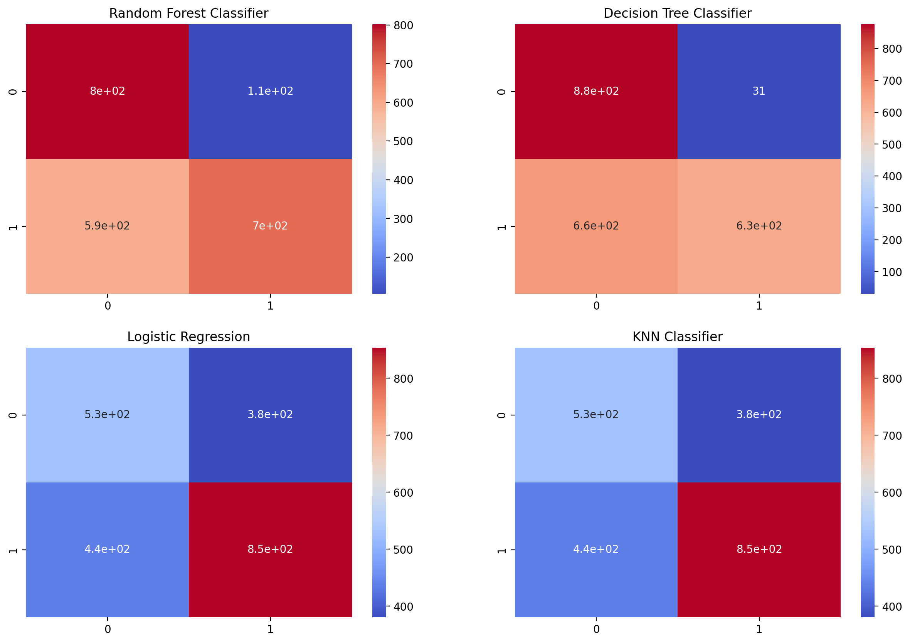
Model Evaluation

Slide 10
Key Findings
Insights from EDA and Modeling:
Product Factors:
Products between 2500-3500 grams delivered on time more often.
High-value products ($250+) experienced delays.
Warehouse Logistics:
Warehouse F processed a majority of on-time deliveries, likely due to saport proximity.
Customer Behavior:
Frequent customer care calls indicated delivery issues.
Repeat customers benefited from more reliable deliveries.
Discounts:
Offers >10% improved delivery punctuality.

Slide 11
Conclusion
The project successfully identified key factors affecting delivery performance.
A robust predictive model helps streamline logistics and improve operational efficiency.
The insights gained can help the company adjust its shipping methods and warehouse distribution strategies

Slide 12
Recommendations
Improve
Improve efficiency at Warehouse F by optimizing shipment schedules and diversifying transport modes.
Enhance
Enhance logistic tracking for high-cost and high-weight items to reduce delays.
Offer
Offer predictive insights to customers on potential delivery delays based on real-time factors.
Optimize
Optimize discounts strategically, as excessive discounts correlate with delayed shipments.

Slide 13


Slide 14
Streamlit UI
Developed an interactive Streamlit UI for predicting e-commerce product delivery times.
The UI allows users to input key details related to orders and predicts the expected delivery time.
Features of the UI:
User Input Section:
Users can enter product details like order date, product type, shipping address, etc.Includes a form to capture real-time data for prediction.
Prediction Output:
Based on the input, the model predicts the delivery time and displays the result.Provides visualizations or charts to enhance user understanding.

Slide 15
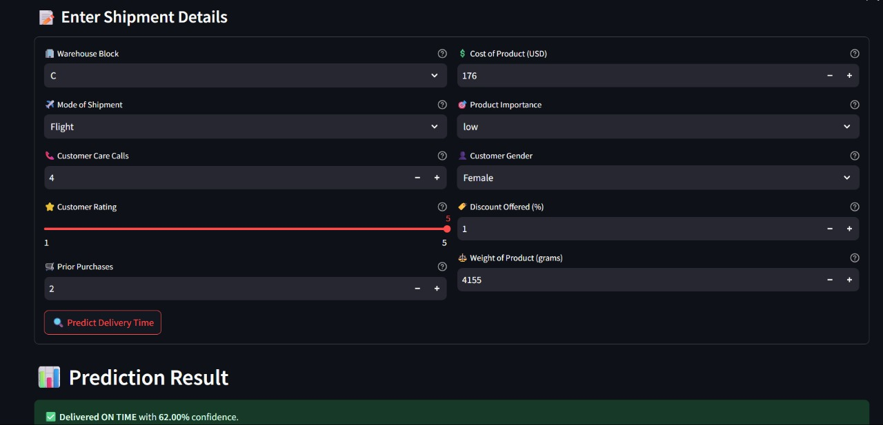
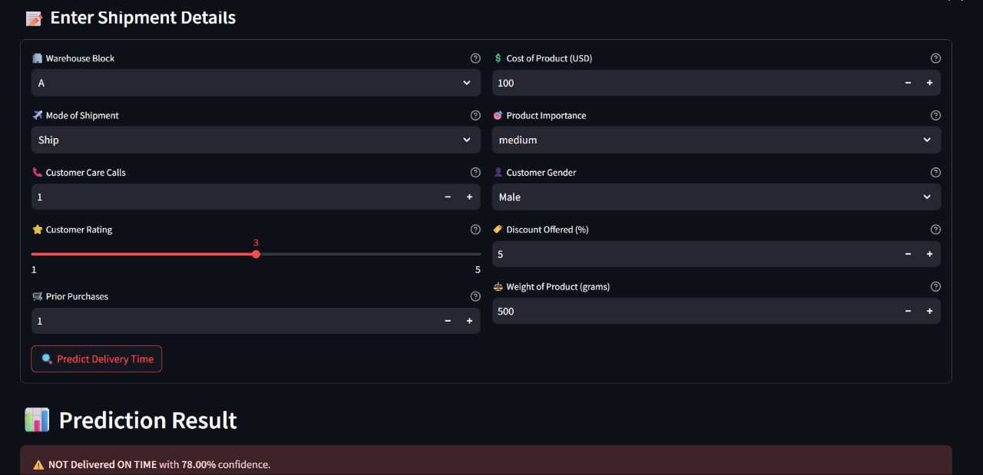

Slide 16
Future Work
- Use real-time data: Add live tracking and customer info to improve predictions.
- Try advanced models: Test deep learning and better ML models for higher accuracy.
- Analyze routes and locations: Use route data to make deliveries faster and timely.
- Build alert systems: Send early alerts if a delivery might be delayed.
- Deploy and improve: Use the model in real life and improve it with new data.

Slide 17
Thank You!

